Slide 1
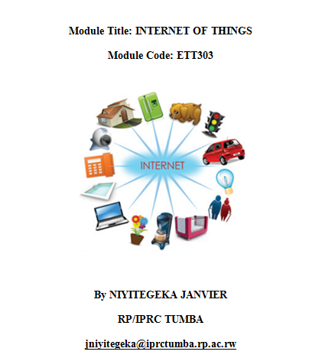

Slide 2
Plan of Presentation
What is Internet of Things?
How IoT Works?
Current Status & Future Prospect of IoT
Features of IoT
Advantages of IoT
Disadvantages of IoT
Applications of IoT
Challenges of IoT

Slide 3
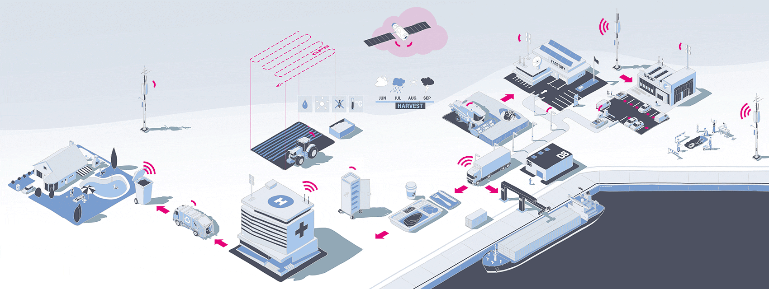
Introduction
Internet of Things (IoT) comprises things that have unique identities , connected to the Internet and can communicate and share information

Slide 4

What is IoT
The Scope of IoT is not limited to just connecting things (device, appliances, machines) to the Internet
IoT allows these things to communicate and exchange data (control& information)
Processing on these data will provide us various applications towards a common user or machine goal

Slide 5
Definitions?
The Internet of Things (IoT) is the network of physical objects or "things" embedded with electronics, software, sensors, and network connectivity, which enables these objects to collect and exchange data.
IoT allows objects to be sensed and controlled remotely across existing network infrastructure.

Slide 6
Cont’d
Extending the current Internet and providing connection, communication, and inter-networking between devices and physical objects, or "Things," is a growing trend that is often referred to as the Internet of Things.
“The technologies and solutions that enable integration of real world data and services into the current information networking technologies are often described under the umbrella term of the Internet of Things (IoT)”

Slide 7
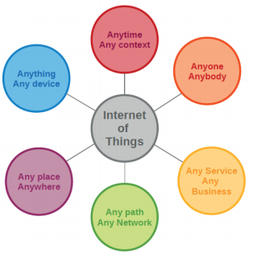

Slide 8
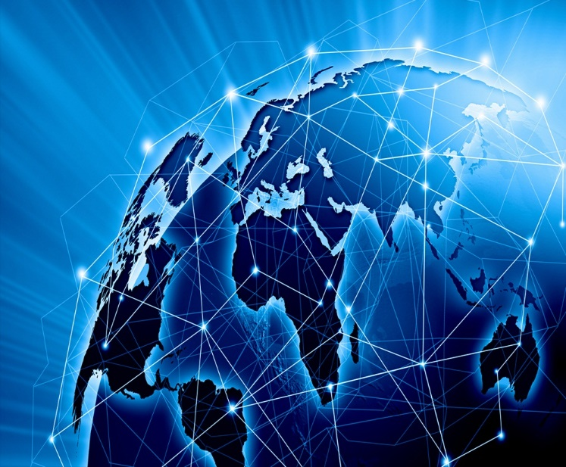
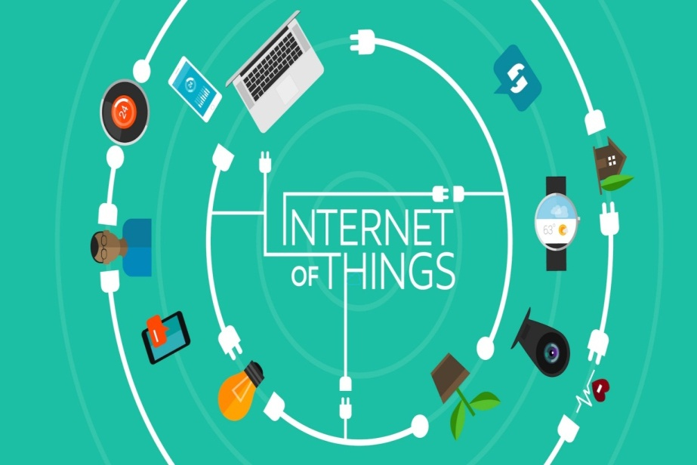
Move from Internet of People → Internet of Things
Internet appears everywhere in the world
It is primarily connection between people
Internet of Things is a plan to connect things also using the same medium

Slide 9







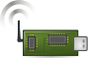
How does Internet of Thing (IoT) Work
End-user
Core network
e.g. Internet
Gateway
Sink
node
Gateway
Computer services

Slide 10
How does Internet of Thing (IoT) Work?
The entire working process of IoT starts with the device themselves, such as smartphones, digital watches, electronic appliances, which securely communicate with the IoT platform.
The platforms collect and analyze the data from all multiple devices and platforms and transfer the most valuable data with applications to devices

Slide 11




IOT: People connecting with Things
ECG sensor
Internet
Motion sensor
Motion sensor
Motion sensor

Slide 12
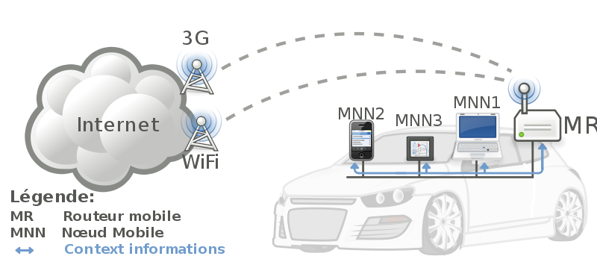


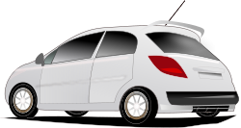
IoT: Things connecting with Things
- Complex and heterogeneous
resources and networks

Slide 13
IoT VISION and EVOLUTION

Slide 14
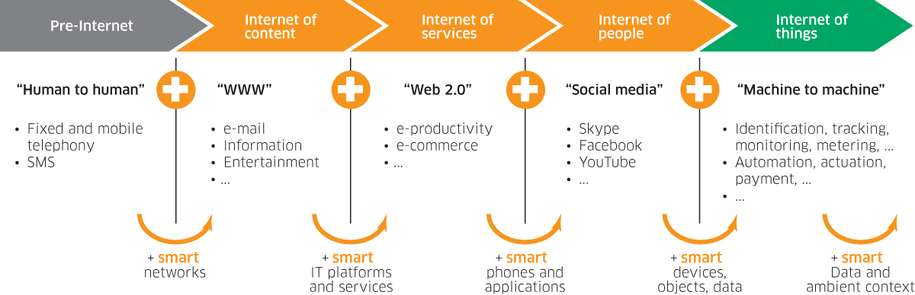
Internet of Things - Evolution

Slide 15
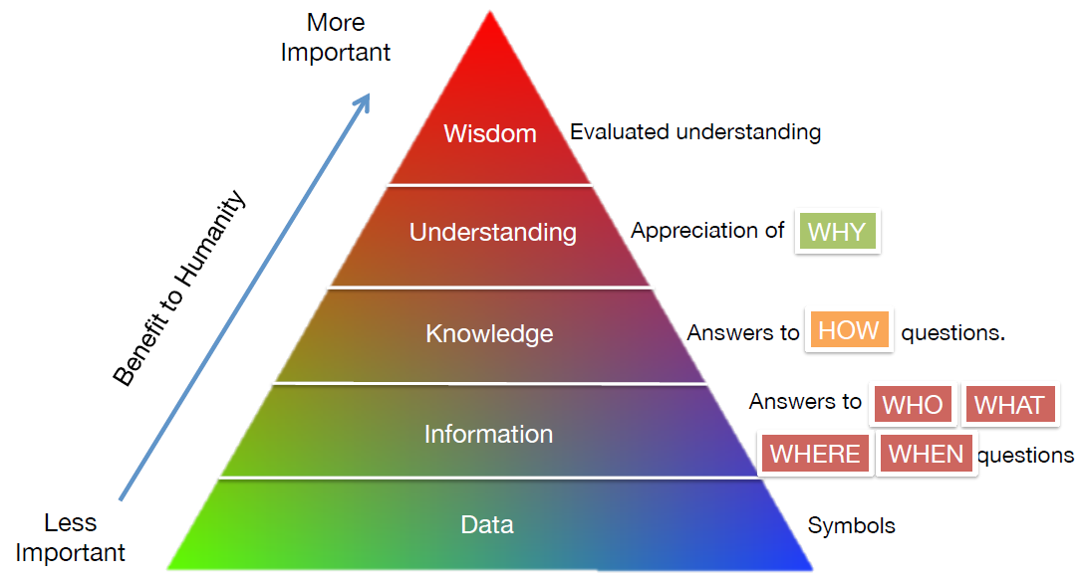
Knowledge Management – Turning Data into Wisdom
The more data that is created, the better understanding and wisdom people can obtain.

Slide 16
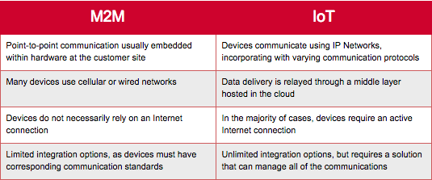
Difference between M2M and IoT

Slide 17
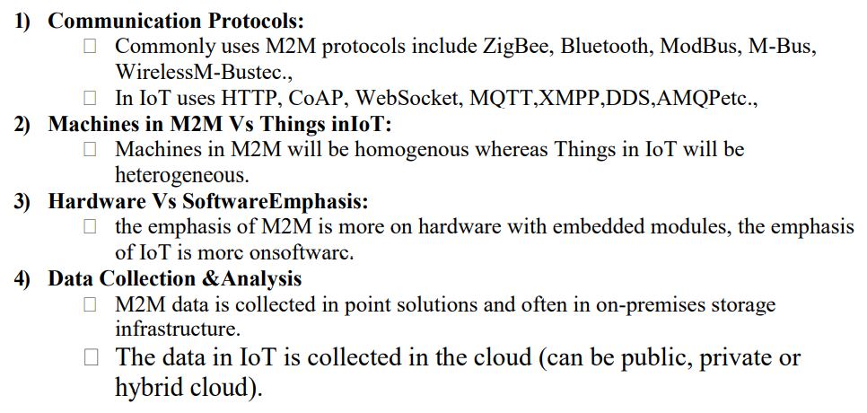
Difference between M2M and IoT

Slide 18
Features of IOT
Connectivity: There is a proper connection between all the things of IoT to IoT .
Analyzing: After connecting all the relevant things, it comes to real-time analyzing the data collected and use them to build effective business intelligence.

Slide 19
Cont’
Integrating: IoT integrating the various models to improve the user experience as well.
Artificial Intelligence: IoT makes things smart and enhances life through the use of data.

Slide 20
Cont’
Active Engagement: IoT makes the connected technology, product, or services to active engagement between each other.
Sensing: The sensor devices detect and measure any change in the environment and report on their status.
Endpoint Management: It is important to be the endpoint management of all the IoT system otherwise, it makes the complete failure of the system.

Slide 21
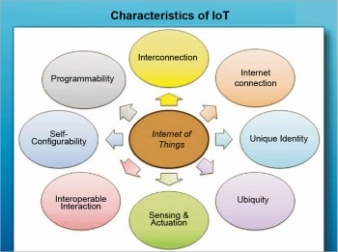
Characteristics of IoT

Slide 22
Quiz1
1) Define the following terms
a) IoT
b) Things
2) Explain any three(3) features of IoT

Slide 23
Advantages &Disadvantages of IoT
Internet of Things has a significant technology in a world that can help other technologies to reach its accurate and complete 100 % capability as well.
Let us see some advantages and disadvantages of internet of things

Slide 24
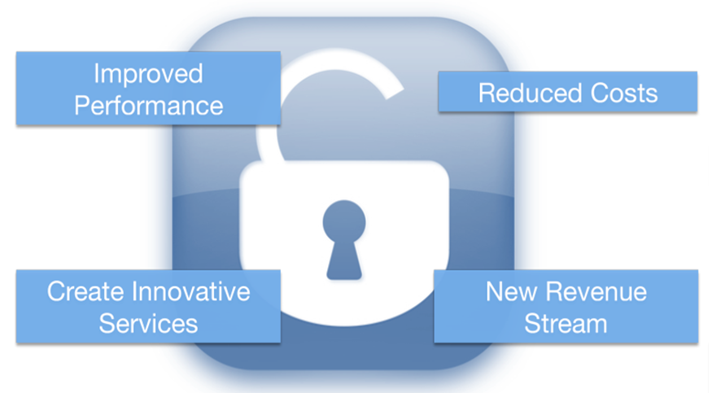
Potentials of IoT

Slide 25
Advantages
Efficient resource utilization: If we know the functionality and the way that how each device work we definitely increase the efficient resource utilization as well as monitor natural resources.
Minimize human effort: As the devices of IoT interact and communicate with each other and do lot of task for us, then they minimize the human effort.

Slide 26
Cont’
Save time: As it reduces the human effort then it definitely saves out time.
Improve security: Now, if we have a system that all these things are interconnected then we can make the system more secure and efficient.

Slide 27
Disadvantages of IoT
Security: As the IoT systems are interconnected and communicate over networks. The system offers little control despite any security measures, and it can be lead the various kinds of network attacks.

Slide 28
CONT’
Privacy: Even without the active participation on the user, the IoT system provides substantial personal data in maximum detail.
Complexity: The designing, developing, and maintaining and enabling the large technology to IoT system is quite complicated.

Slide 29
CONT’
Privacy: Even without the active participation on the user, the IoT system provides substantial personal data in maximum detail.
Complexity: The designing, developing, and maintaining and enabling the large technology to IoT system is quite complicated.

Slide 30
IoT Enabling Technologies
Wireless Sensor Network(WSN)
Cloud Computing: Services are offered to users in forms of Infrastructure-as-a-service(IaaS), Platform-as-a-Service(PaaS), Software-as-a-Service(SaaS).
Big Data Analytics
Communication Protocols
Embedded Systems

Slide 31
IoT Challenges

Slide 32
a) Data storage and analytics
Processing and storing the huge amount of data obtained from sensors in real time impose another challenges

Slide 33
b) Lack of common technical standards.
Currently, a wide variety of IoT devices (in terms of both hardware and the differences in the software running on them) makes the task of developing different applications that work consistently across different inconsistent technical systems, difficult.

Slide 34
c) Complexity and unclear value propositions
According to the feedback of several users, IoT solutions are either too complex or lack a clear use case for different end users.

Slide 35
d) Traditional governance structures
There is a clash between IoT and the companies’ traditional governance structures, as IoT still presents both uncertainties and the lack of historical precedence.

Slide 36
e) lack interoperability and standards
The number of vendors, technologies and protocols used by each class of smart devices inhibits interoperability.
The lack of consensus on how to apply emerging standards and protocols to allow smart objects to connect and collaborate makes it difficult for organizations to integrate applications and devices that use different network technologies and operate on different networks.

Slide 37
IoT Applications and Future prospects

Slide 38
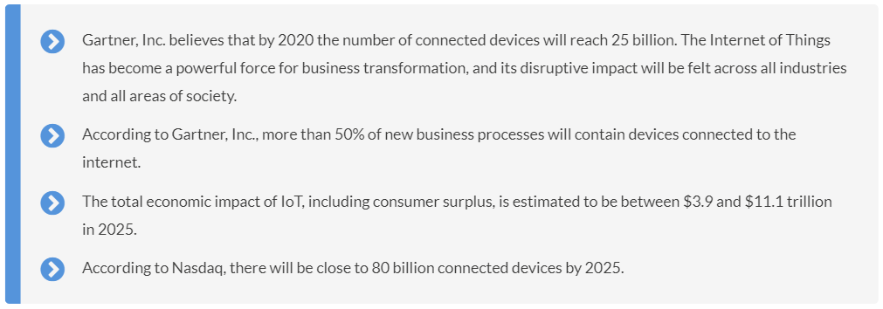
Future prospects
According to Cisco’s Annual Internet Report, by 2023, there will be nearly 30 billion network connected devices and connections, up from 18.4 billion in 2018. Of those, IoT devices will account for 50% (14.7B) of all networked devices by 2023, compared to 33% (6.1B) in 2018.

Slide 39
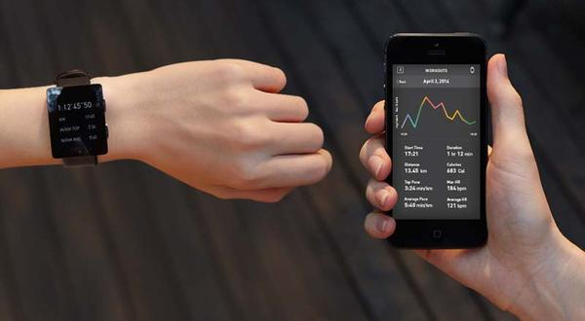
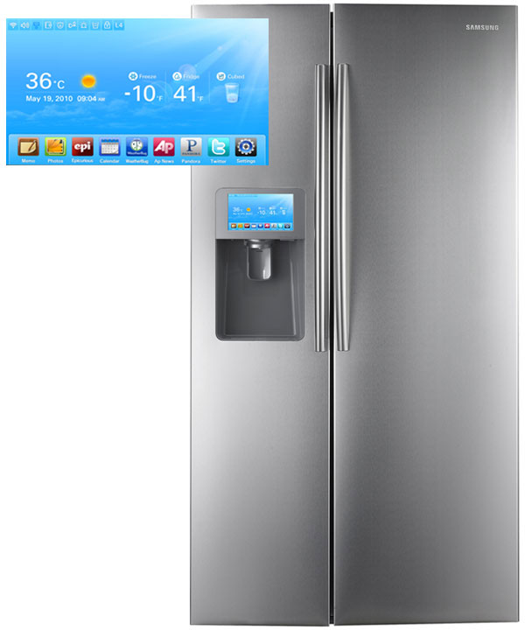
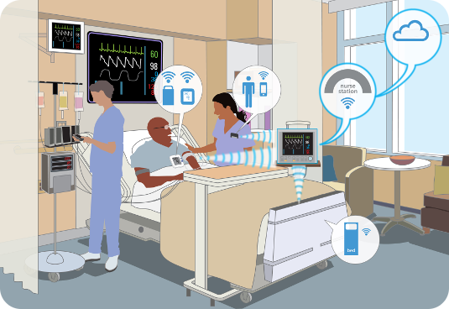
Information Security
Office of Budget and Finance
Education – Partnership – Solutions
Smart Appliances
Wearable Tech
Healthcare
Notes:
In our daily lives, we have become more reliant on IoT with our wearable tech, appliances, our cars, how we receive health care.

Slide 40
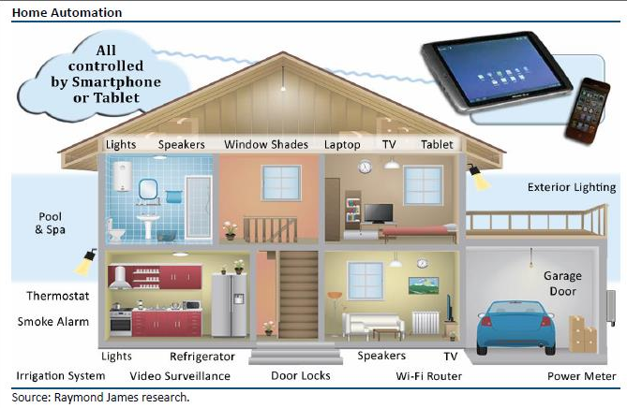
IoT Applications : Intelligent Home

Slide 41
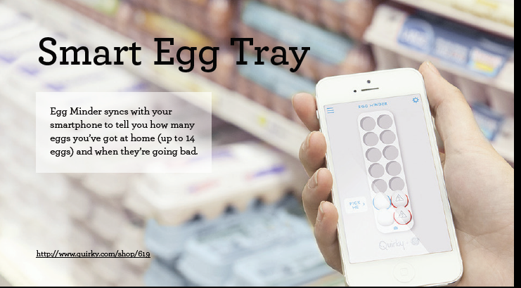

Slide 42
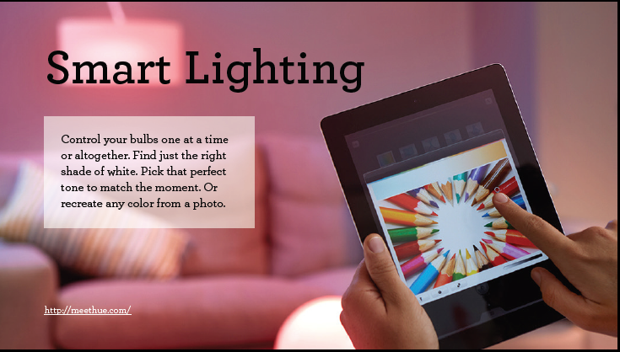

Slide 43
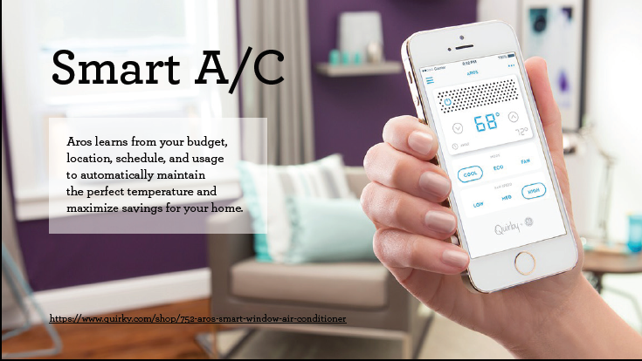

Slide 44
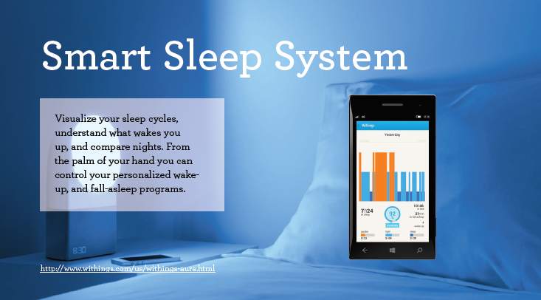

Slide 45
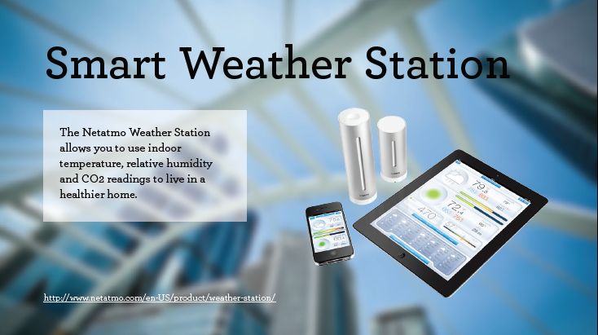

Slide 46
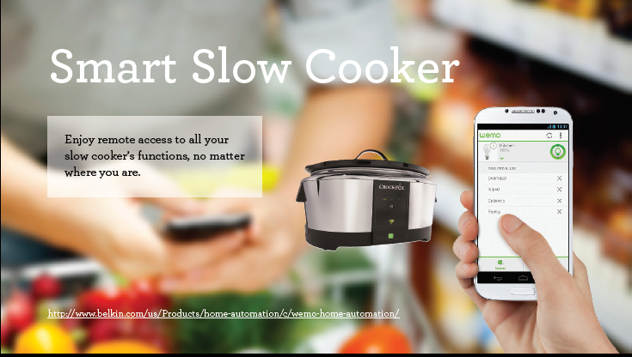

Slide 47
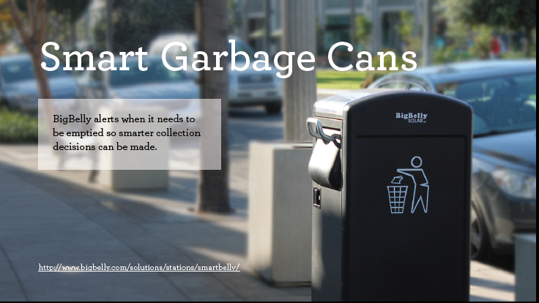

Slide 48


Slide 49
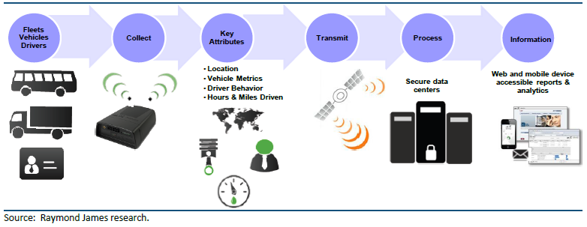
IoT Applications : Transportation

Slide 50
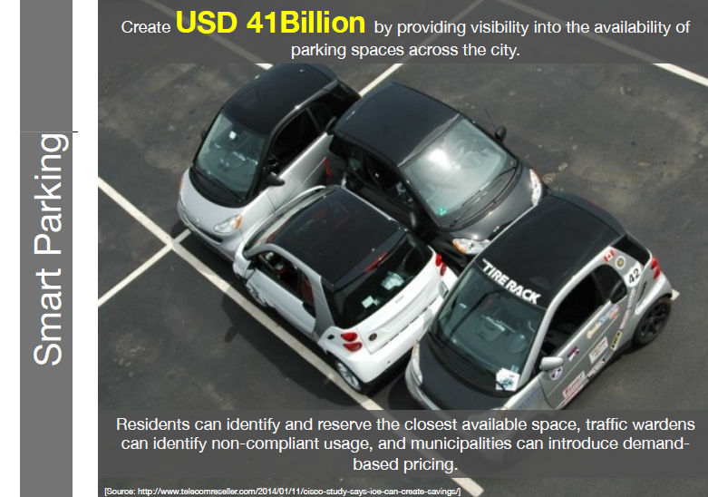

Slide 51
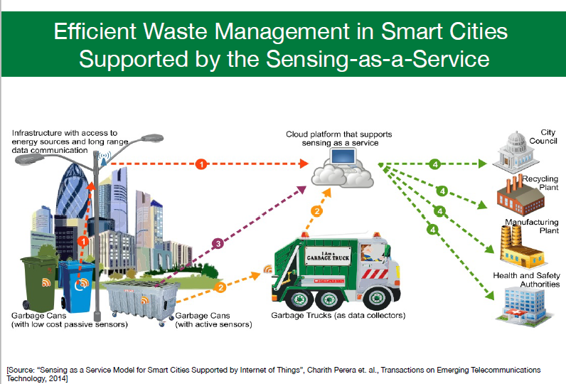

Slide 52
Sensors in even the holy cow!
In the world of IoT, even the cows will be connected and monitored. Sensors are implanted in the ears of cattle. This allows farmers to monitor cows’ health and track their movements, ensuring a healthier.

Slide 53
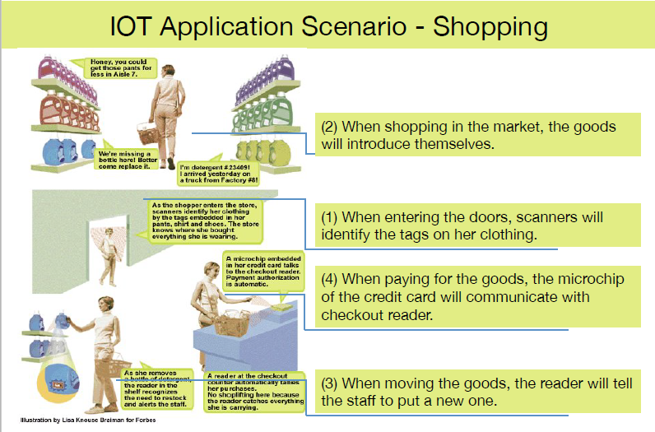

Slide 54
References
Tracking the Evolution of the Internet of Things Concept Across Different Application Domains . Jorge E. Ibarra-Esquer 1,*, Félix F. González-Navarro 2, Brenda L. Flores-Rios 2, Larysa Burtseva 2 and María A. Astorga-Vargas 1
https://en.wikipedia.org/wiki/Internet_of_Things
Cisco whitepaper, "The Internet of Things" - How the Next Evolution of the Internet Is Changing Everything, by Dave Evans, April 2011.
GE cloud expo 2014, "Industrial Internet as a Service", by Shyam Varan Nath, Principal Architect.

Slide 55

Questions and Discussion
Information Security
Office of Budget and Finance
Education – Partnership – Solutions
Notes:
Questions and Answers section

